Slide 1
Linux
CHAPTER 1
INTRODUCTION
Computer has become very important nowadays because it is very much accurate, fast and can accomplish many tasks easily. Otherwise to complete those tasks manually much more time is required. It can do very big calculations in just a fraction of a second. Moreover it can store huge amount of data in it. We also get information on different aspects using internet on our computer

Slide 2

CHAPTER 2
LINUX
Linux is free and open source operating system(OS) released under the GNU General Public License(GPL) best-known and most-used . Linux was designed to be similar to UNIX, but has evolved to run on a wide variety of hardware from phones to supercomputers. Every Linux-based OS involves the Linux kernel—which manages hardware resources—and a set of software packages that make up the rest of the operating system.
The OS includes some common core components, like the GNU tools, among others. These tools give the user a way to manage the resources provided by the kernel, install additional software, configure performance and security settings, and more. All of these tools bundled together make up the functional operating system. Because Linux is an open source OS, combinations of software can vary between Linux distributions
Linux is a free, , (GPL). Anyone can run, study, modify, and redistribute the source code, or even sell copies of their modified code, as long as they do so under the same license.
2.1History of Linux
The Unix operating system was conceived and implemented
by Ken Thompson and Dennis Ritchie (both of AT&T Bell
Laboratories) in 1969 and first released in 1970. Later they
rewrote it in a new programming language,C, to make it portable .
The availability and portability of Unix caused it to be widely
adopted, copied and modified by academic institutions and
businesses.
● In 1977, the Berkeley Software Distribution (BSD)
was developed by the Computer Systems Research Group
(CSRG) from UC Berkeley, based on the 6th edition of Unix from AT&T. Since BSD contained Unix code that AT&T owned, AT&T filed a lawsuit (USL v. BSDi) in the early 1990s against the University of California. This strongly limited the development and adoption of BSD
● In 1983, Richard Stallman started the GNU project with the goal of creating a free UNIX-like operating system. As part of this work, he wrote the GNU General Public License (GPL). By the early 1990s, there was almost enough available software to create a full operating system. However, the GNU kernel, called Hurd, failed to attract enough development effort, leaving GNU incomplete.[citation needed]
● In 1985, Intel released the 80386, the first x86 microprocessor with a 32-bit instruction set and a memory management unit with paging.
● In 1986, Maurice J. Bach, of AT&T Bell Labs, published The Design of the UNIX Operating System This definitive description principally covered the System V Release 2 kernel, with some new features from Release 3 and BSD.
Ken Thompson and Dennis Ritchie, creators of the UNIX operating system

Slide 3
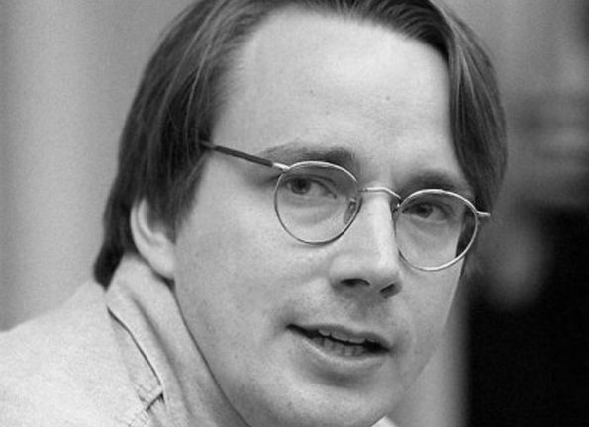
● In 1987, MINIX, a Unix-like system intended for academic use, was released by Andrew S. Tanenbaum to exemplify the principles conveyed in his textbook, Operating Systems:
Design and Implementation. While source code for the system was available, modification and redistribution were restricted. In addition, MINIX's 16-bit design was not well adapted to the 32-bit features of the increasingly cheap and popular Intel 386 architecture for personal computers. In the early nineties a commercial UNIX operating system for Intel 386 PCs was too expensive for private users
These factors and the lack of a widely adopted, free kernel provided the impetus for Torvalds' starting his project. He has stated that if either the GNU Hurd or 386BSD kernels had been available at the time, he likely would not have written his own
● In 1991, while studying computer science at University of Helsinki, Linus Torvalds began a project that later became the Linux kernel. He wrote the program specifically for the hardware he was using and independent of an operating system because he wanted to use the functions of his new PC with an 80386 processor.
Linus Torvalds
Development was done on MINIX using the GNU C Compiler.
As Torvalds wrote in his book Just for Fun,[13] he eventually ended up writing an operating system kernel. On 25 August 1991, he (at age 21) announced this system in a Usenet posting to the newsgroup "comp.os.minix.":
Hello everybody out there using minix -
I'm doing a (free) operating system (just a hobby, won't be big and professional like gnu) for 386(486) AT clones. This has been brewing since april, and is starting to get ready. I'd like any feedback on things people like/dislike in minix, as my OS resembles it somewhat (same physical layout of the file-system (due to practical reasons) among other things).
I've currently portedÂ bash(1.08) and gcc(1.40), and things seem to work. This implies that I'll get something practical within a few months, and I'd like to know what features most people would want. Any suggestions are welcome, but I won't promise I'll implement them :-)
Linus (torvalds@kruuna.helsinki.fi)
PS. Yes - it's free of any minix code, and it has a multi-threaded fs . It is NOT portable (uses 386 task switching etc), and it probably never will support anything other than AT-harddisks, as that's all I haveÂ :-(.
– Linus Torvald
According to Torvalds, Linux began to gain importance in 1992 after theÂ X Window SystemÂ was ported to Linux byÂ Orest Zborowski, which allowed Linux to support aÂ GUIÂ for the first time

Slide 5
Linux, computer operating system created in the early 1990s by Finnish software engineer Linus Torvalds and the Free Software Foundation (FSF).
. An operating system is the software that directly manages a system’s hardware and resources , like CPU . Memory , and storage
The OS sits between application and
Linux has become the largest open sources software project in the world. Professional and hobbyist programmers from around the world contribute to the Linux kernel, adding features, finding and fixing bugs and security flaws, and providing new ideas—all while sharing their contributions back to the community.
●

Slide 6
Linux CompleteÂ
John Wiley & Sons Inc

